Slide 1
CHAPTER 7
WIDE AREA NETWORK AND BROADBAND TECHNOLOGIES

Slide 2
Introduction
Quality of Service (QoS)
  It refers to a set of characteristics that define the delivery behavior of different types of network traffic and provide certain guarantees
Latency (Transit delay)
  It is the end-to-end delay that a signal element experiences as it moves across the network
Jitter (Variation)
  It is the variability (in effect, the standard deviation) of the latency in the network

Slide 3
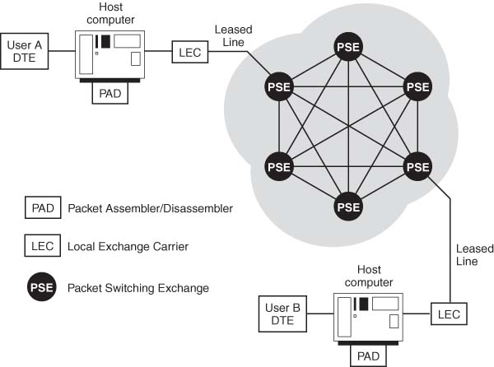
Packet Switching Networks

Slide 4
X.25
It is one of the first packet-switching technologies
This technique involves error checking at every node and continual message exchange regarding the progress of packets, from node to originator and from node to destination
The X.25 intensive processing for every link imposes excessive latency that is rather unnecessary because today’s fiber-optic networks have negligible error rate (10⁻⁹)

Slide 5
Frame Relay
Layer 2 technology; it is a fast packet-switching technique that provides a cost efficient means of connecting an organization’s multiple LANs
Connections are established using a pre-defined network connection of virtual circuits, called Permanent Virtual Circuit (PVC)
The access or delivery rate, called Committed Information Rate (CIR), is also pre-specified
  A guaranteed rate of throughput when using Frame Relay

Slide 6
Committed Information Rate (CIR)
CIR + Br + Be = Total Throughput
where,
Br: Burst rate
Be: Burst Excess rate
There are some carriers that do not allow bursting, while some may allow it but limit it to two seconds or less.

Slide 7
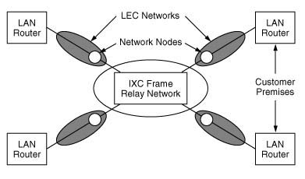
Frame Relay

Slide 8
Advantages of Frame Relay
Supports interconnection of LANs running multiple protocols, including Appletalk, SNA, DecNet, X.25, IPX, and TCP/IP, which provides fairly robust interoperability between various switching platforms
Increased utilization of network and resultant savings
Reduced network downtime due to automatic rerouting of network links within the cloud

Slide 9
Switched MultiMegabit Data Service (SMDS)
A public, packet-switched service aimed at enterprises that do not want to commit to predefined PVCs but need to exchange large amounts of data with other enterprises over a WAN on a bursty basis.
Its goal is to provide high-speed data transfer on a switched, as-needed basis
Uses a technique called Distributed Queue on a Dual Bus (DQDB)
Sustained Information Rate (SIR) in SMDS is similar to CIR in Frame Relay
  Based on one of five classes of service

Slide 10
Integrated Services Digital Network (ISDN)
It was developed as a way for telecommunications companies to support data and voice transmission over a single line, using end-to-end digital connectivity
ISDN User-to-Network Interface has two categories
  Basic Rate Interface (BRI)
    Appropriate for a single two-wire subscriber loop, typically for an advanced user or home office application.
  Primary Rate Interface (PRI)
    Appropriate for a business that utilizes a T-1 line

Slide 11
BRI and PRI
Basic Rate Interface: 2B + D
  Two 64 kbps bearer (B) channels that carry voice, data, or video
  One 16 kbps data (D) channel which provides intelligent line management (out-of-band signaling)
Primary Rate Interface in the US: 23B + D
  Twenty-three 64 kbps B channels, and One 64 kbps D channel, yielding 1.536 Mbps line (equivalent to T-1)
Primary Rate Interface International: 30B + 2D
  Thirty 64 kbps bearer (B) channels and Two 64 kbps D channels yield 2.048 Mbps line (same as E-1)

Slide 12
Advantages and Disadvantages of ISDN
Advantages of ISDN
  Offers enhanced calling features and digital voice quality
  Provides 128 kbps channel for Internet
  Availability of three channels, with the D channel used as an Always On conduit that enables a third call
  Can handle three channels simultaneously when needed
    Telephone call, Internet connection, and a Fax
Disadvantages of ISDN
  Relatively expensive
  Limited availability
  Relatively difficult to configure compared to an analog modem

Slide 13
Synchronous Optical Network (SONET)
A physical layer or Layer 1 technology first conceived in the mid-1980s by MCI Communications
Transmits data in frames over WAN fiber-optic lines
STS-1 Transmission Rate = 51.84 Mbps
(8000 frames/s) x (810 bytes/frame) x (8 bits/byte)

Slide 14
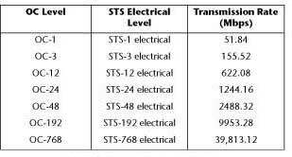
SONET Transmission Rate

Slide 15
Advantages of SONET
Every type of communications traffic can be multiplexed into SONET
Scalable
Standardized
Built-in fault tolerance called Automatic Protection Switching (APS)
  Use of redundant strings of fiber so that if a break occurs, traffic can be switched to another fiber within microseconds

Slide 16
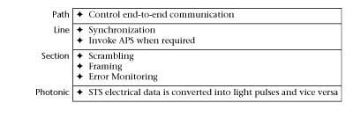
SONET Protocol

Slide 17
STS-1 Frame Structure
Each STS-1 frame is 9-row by 90-column, for a total of 810 bytes
Frame is divided into two areas
  Transport overhead: First 3 columns (27 bytes)
    Section overhead (9 bytes)
    Line overhead (18 bytes)
  Synchronous Payload Envelope (SPE): Next 87 columns
    STS Path overhead (9 bytes)
    Payload (actual message bits)
    The order of filling data is row-by-row from top-to-bottom and from left-to-right (with MSB first)

Slide 18
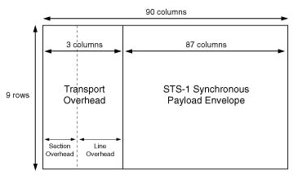
STS-1 Frame Format

Slide 19
Asynchronous Transfer Mode (ATM)
Cell-based Layer 2 transport mechanism that evolved from the development of the Broadband ISDN (B-ISDN) standards
ATM was devised for transport of a broad range of information: voice, data and video
Cell relay combines the high throughput and bandwidth utilization of Frame Relay and predictability of TDM, making it suitable for voice/video traffic and data transmission

Slide 20
ATM Cell
ATM cell is a fixed unit of 53 bytes (also called octets)
  5 byte header (overhead) and 48 bytes of payload (message bits)
ATM cells are transmitted synchronously and continuously, whether or not data is being sent
When user sends data, it is allocated to cells dynamically, without any waiting period, hence the term Asynchronous in ATM
Packetization delay refers to the time it takes to fill a cell, which must be kept minimal for efficient voice transmission
ATM utilizes Switched Virtual Circuits (SVCs) that minimize reconfiguration complexity, rather than PVCs

Slide 21
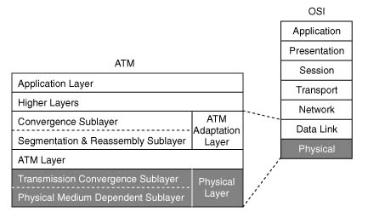
ATM Layers related to OSI Model

Slide 22
Advantages of ATM
Popular network backbone solution
Ensures true QoS on a per-connection basis so that real-time traffic such as voice and video and mission-critical data can be transmitted without introducing latency and jitter
A single network for voice, video, and data
An ATM network will not give traffic access unless it can ensure a contracted QoS. In that case, a data stream may get the equivalent of a busy signal
Data that is not time-sensitive is given leftover capacity and pays lower fare for sacrificing guaranteed QoS

Slide 23
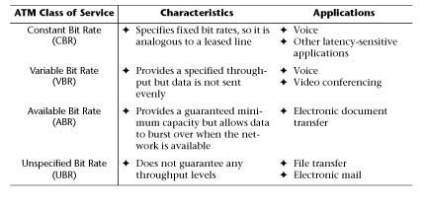
ATM Classes of Service

Slide 24

Perceived Quality versus Latency

Slide 25
Drawbacks of ATM
Cell Tax
  Overhead for converting IP traffic to ATM
  Segmentation-and-reassembly (packet-to-cell conversion) results in wasted bandwidth with pure IP traffic
  Packetization delay
Requires different expertise and management techniques as compared to Ethernet
Many networks do not require the QoS that ATM offers

Slide 26
Gigabit Ethernet versus
ATM in LAN backbone
Evolutionary: Gigabit Ethernet
Revolutionary: ATM

Slide 27
Packet over SONET (PoS)
IP over SONET
Designed specifically for high speed, high volume IP packet traffic; lends itself well to a data-only network
PoS is optimized for variable-length packets rather than fixed-length ATM cells
IP (discussed in Chapter 8) is a Layer-3 protocol, and the PoS technique employs one of the Layer-2 protocols
  Typically PPP
  With no ATM, QoS is added at Layer 3 implementing MPLS, also discussed in Chapter 8

Slide 28
Dynamic Synchronous Transfer Mode (DTM)
A new broadband Layer 2 technology that helps enterprise networks efficiently carry voice, data and streaming video on a single, integrated network
Combines the advantages of circuit and packet switching
A relatively new technology, therefore it has not yet been carefully scrutinized and lacks international standards, as opposed to ATM

Slide 29
Residential or Small Business “Wired” Access Technologies
Digital Subscriber Line (DSL)
  Delivers broadband services, speeds depend on the type of DSL and loop links
  Availability limited to within three-mile radius from DSL-equipped switching office
Cable Modems (CMs)
  Available bandwidth decreases as more people log on
Passive Optical Network (PON)
  Still under experimentation, but cited as potentially the most effective broadband access platform for provisioning advanced multimedia services

Slide 30
Residential or Small Business “Wireless” Access Technologies
Fixed Wireless
  Uses Multi-channel Multi-point Distribution System (MMDS)
  Operates over a licensed spectrum: 2.5 to 2.7 GHz
  Antennas are “fixed” so they can broadcast within a 35-mile radius
  Appropriate for areas too expensive to reach using DSL or CMs
  Speeds comparable to DSL and CMs
Very Small Aperture Terminal (VSAT)
  Satellite communications system in star topology with the satellite providing a link to the hub
  Transceiver at user premises communicates with the satellite

Slide 31
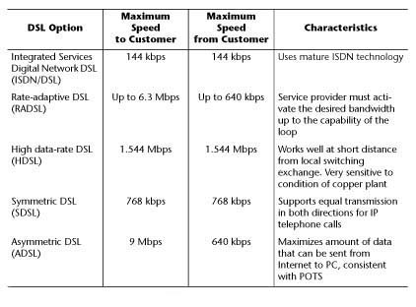
Prominent DSL Technologies

Slide 32
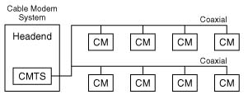
Cable Modem Termination System

Slide 33
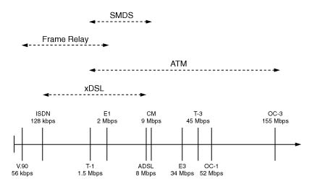
Network Technologies and their Data Rates

Slide 34
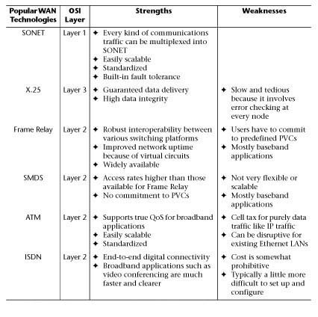
Strengths and
Weaknesses of
Popular
WAN
technologies

